Slide 1
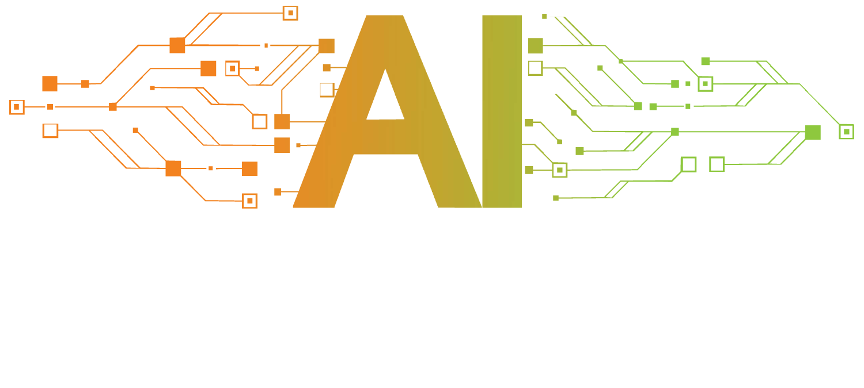

Slide 2

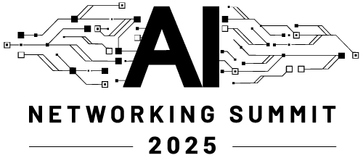
Protocols In the Age of AI: A Cambrian Period of Innovation

Slide 3

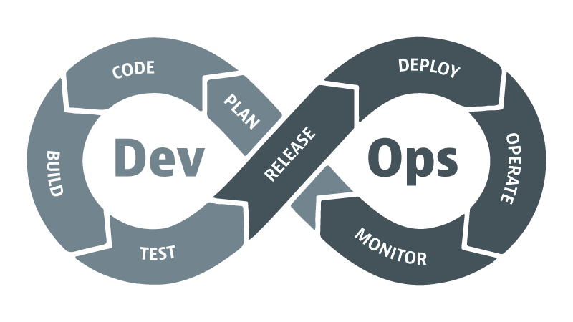
Evolution of Operations
Traditional Operations
Syslog, SNMP
Manual effort
Reactive
AIOps
DevOps
AI Augmentations
Agile
CI/CD
Break down silos
NetDevOps
VibeOps
Infrastructure as Code
Automation
MCP
Agents

Slide 4
Rapid Change Doesn't Come in Normal times
The Technology Infliction Point

Slide 5





Generations of Inflection Points
AI
Cloud
2022 - 2025
Internet
Mobile
Computing
2012 - 2017
1990s – 2007s
2007s – 2015
1970s – 2000s

Slide 6
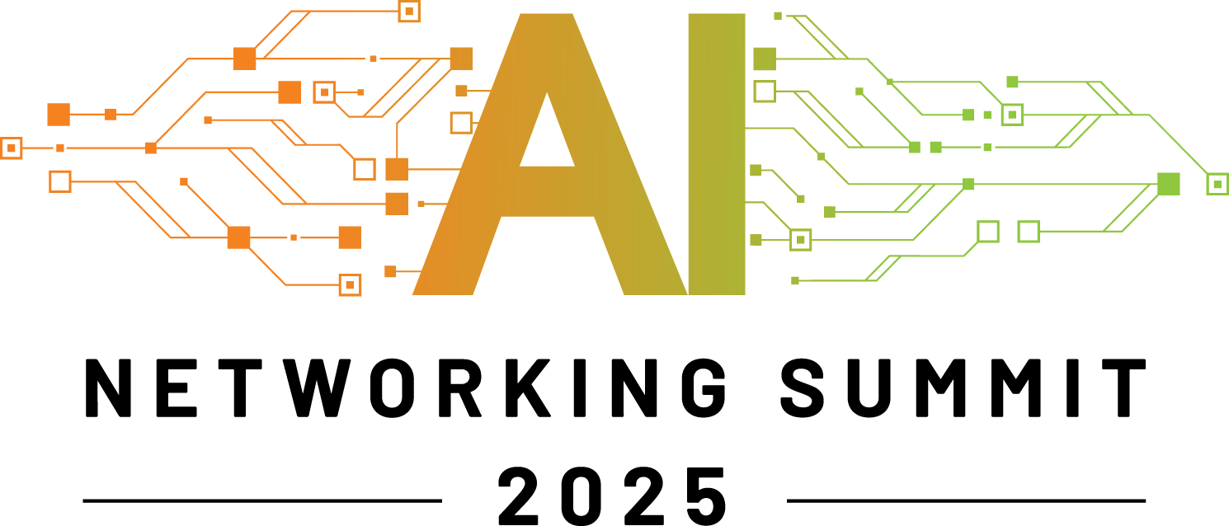
The impact of protocols
Remember or try to imagine society before ….
Simple Mail Transfer Protocol (SMTP)
Hyper-Text Transfer Protocol (HTTP)
Various routing protocols (RIPv2, OSPF, BGP)
E-mail clients
Web browsers
Static routing
E-mail servers
Web servers
Rise of the Internet

Slide 7
What is Model Context Protocol (MCP)?
USB-C of Artificial Intelligence
Anthropic released MCP in late Nov 24
Client / Server Architecture
Since then over 16,000 MCP servers have been made available
MCP Servers offer tools
MCP Client discover and can utilize tools
Embraced universally by Microsoft, Google, openAI, GitHub, AWS
Added to the new CCNP: Automation track
MCP Server can be anything from a REST API, a database, a Python script
Natural Language is the foundation

Slide 8
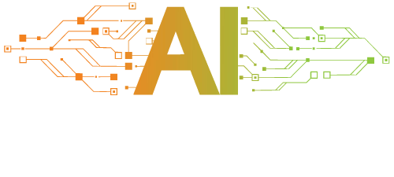
Local Resource A
MCP Server A
MCP
Local Resource B
MCP Host (Claude, IDEs, Tools)
MCP Server B
MCP
MCP Server C
Web APIs
MCP
Internet
Remote Resource C

Slide 9
MCP servers
Servers are quite easy to build using the FastMCP Python package
from mcp.server.fastmcp import FastMCP
Servers can be run locally as stdio mode or remotely hosted such as Selector (remote, secure, streaming MCP)
mcp = FastMCP("pyATS Network Automation Server")
@mcp.tool()
async def pyats_run_show_command()

Slide 10
MCP clients
Many clients have emerged
AI Agents
Claude Desktop / Claude Code
Agents are often powered by MCP Tools the Agent can utilize
ReAct (Reasoning and Actions) Agents where the Actions equal MCP tool calling
Gemini-CLI
VS Code, Cursor, Tailwind (IDEs)
Agency to act without human intervention

Slide 11
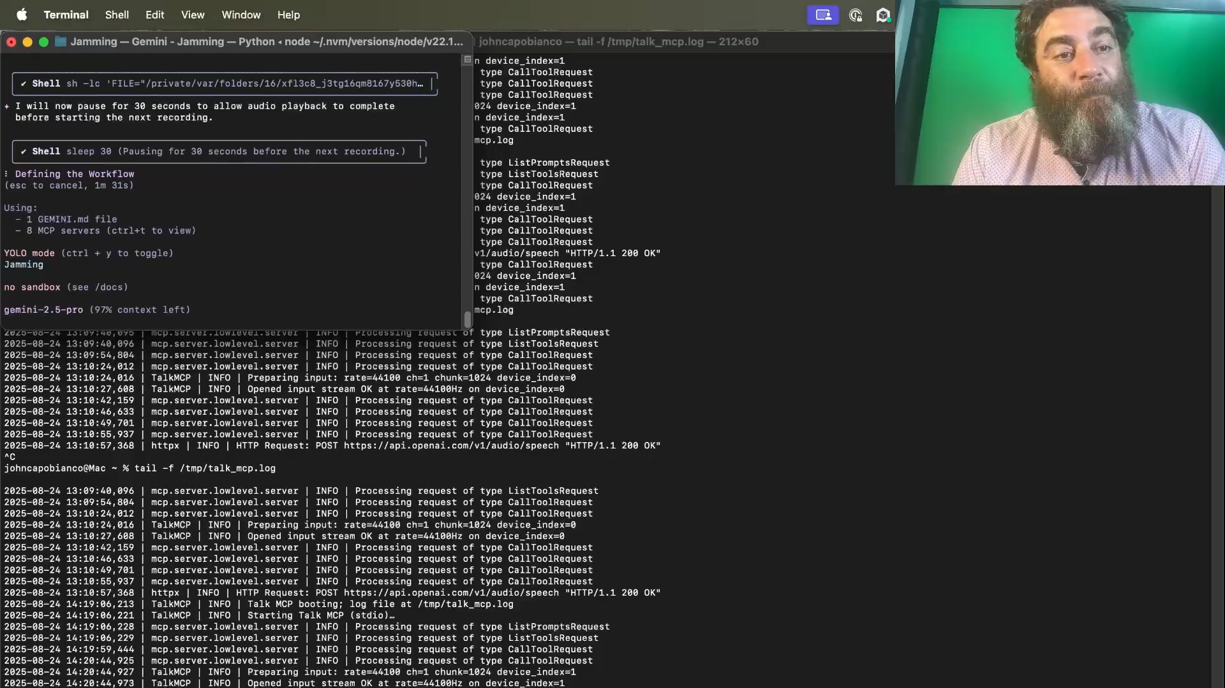

Putting it all together

